Slide 1
Inheritance and Polymorphism
Day 9

Slide 2
Inheritance
Extends the properties of a class.
Reusability
Types
Single Level
Multi Level
Hierarchical
Multiple
class A
{
int i;
void methodOne()
{ System.out.println("From methodOne"); }
}
class B extends A
{
int j;
void methodTwo()
{ System.out.println("From methodTwo"); }
}

Slide 3
1. Only one super class
A superclass can have any number of subclasses but a subclass can have only one super class.

Slide 4
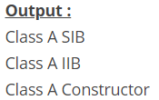
2. Constructors, SIB, IIB
class A
{
int i;
static
{ System.out.println("Class A SIB"); }
{ System.out.println("Class A IIB"); }
A()
{ System.out.println("Class A Constructor"); }
}
class B extends A
{
int j;
}
class MainClass
{
public static void main(String[] args)
{
B b = new B();
}
}
Super class will not be inheriting to its sub class.

Slide 5
3. Inheriting Constructors
A subclass inherits all the members (fields, methods, and nested classes) from its superclass. Constructors are not members, so they are not inherited by subclasses, but the constructor of the superclass can be invoked from the subclass.

Slide 6
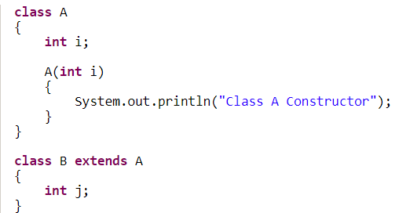
4. Compiler error
Compiler will force you to write constructor in Class B.
In that default constructor, first statement is super() – it is a calling statement to default constructor of Class A. But it is not defined in Class A
Solution: write the constructor for sub class. From that constructor call super class constructor explicitly.

Slide 7

5. Everyone is subclass of Java.lang.object

Slide 8
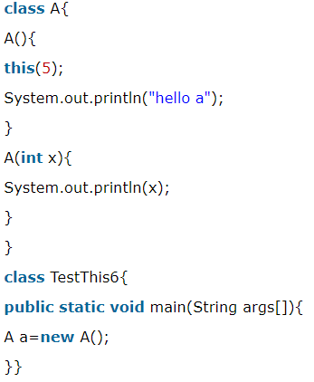
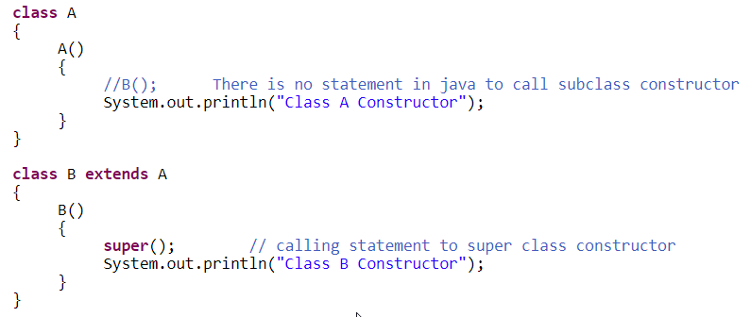
6. Super() and this()
Call super class constructor explicitly through super()
We can call other constructors of the same class through this() calling statement.

Slide 9
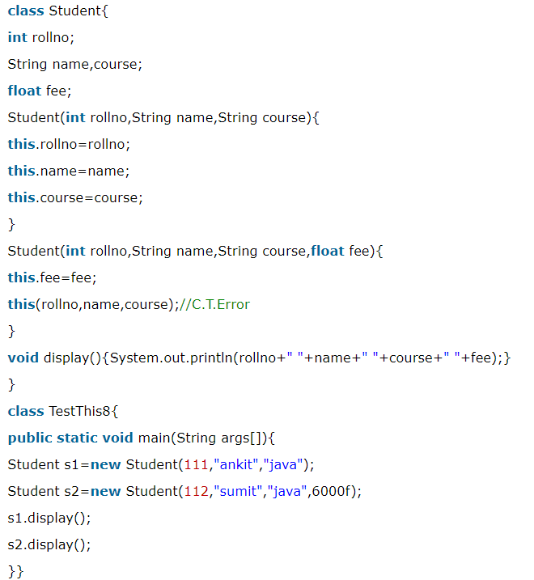
6. this() must be the first statement in constructor.

Slide 10

Access Modifier

Slide 11
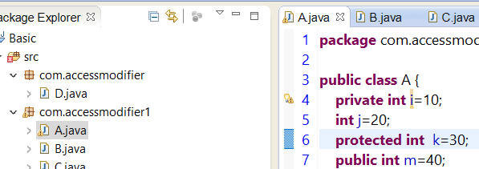
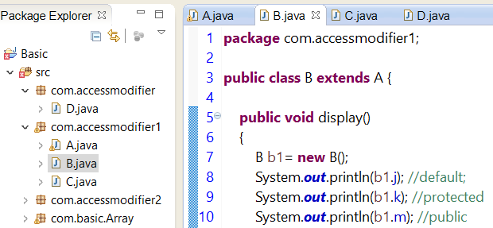
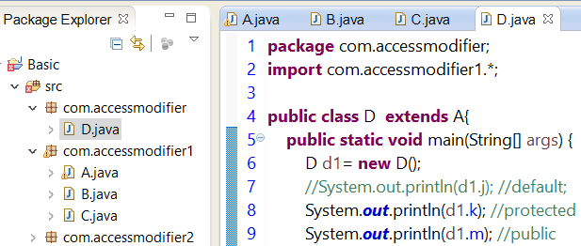

Slide 12
Object Class
getClass()
Wait()
Notify()
notifyAll()

Slide 13
Static Polymorphism
Operator Overloading
Method Overloading
Constructor Overloading
http://www.instanceofjava.com/2016/06/dynamic-polymorphism-in-java-example.html

Slide 14
Dynamic Polymorphism
Method Overridding

Slide 15
Polymorphism : Method Overriding
When a inherited super class method is modified in the sub class, then we call it as method is overridden. Through method overriding, we can modify super class method according to requirements of sub class.

Slide 16
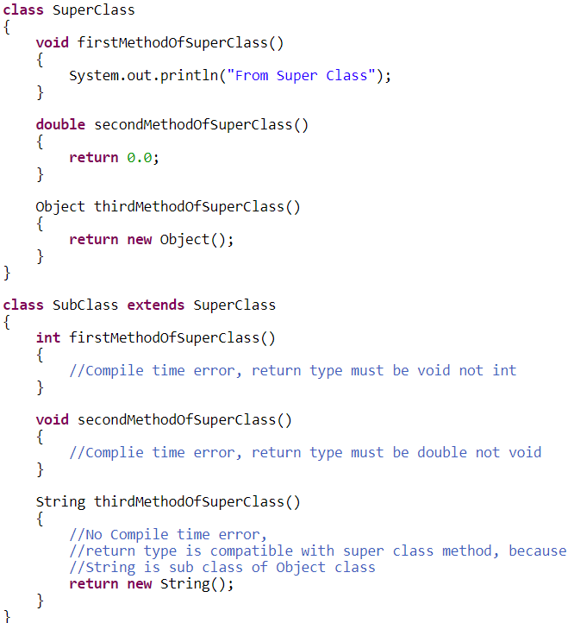
Rule1: of Method Overridden
Must have same
Method name
Return Type Of Overrided Method or subclass of return type
eg: parent “Object” child “String”

Slide 17
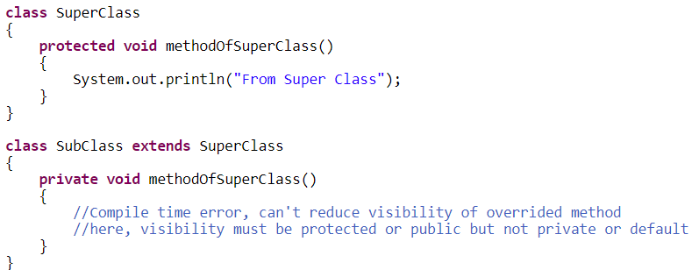
Ride 2: Method Overriding
Visibility of overridden method
Eg: default method can be overrided as default or protected or public method but not as private.

Slide 18
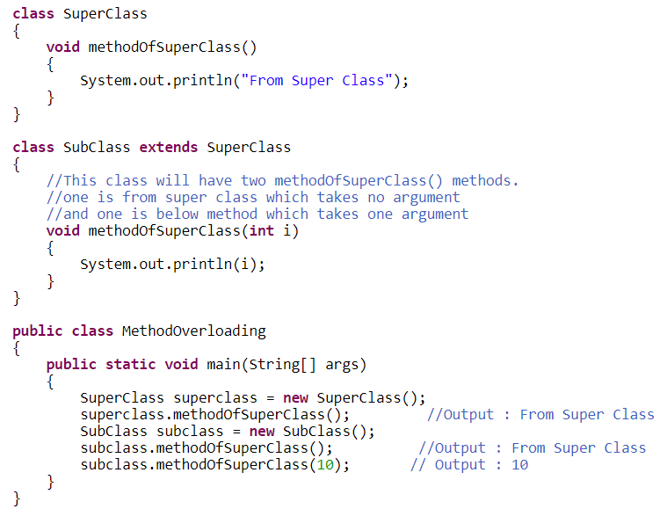
Rule 3: Method Overriding
Argument of overridden methods
You must not change arguments of method in subclass. .
If you change the number of arguments or types of arguments of overrided method in the subclass,
then method will be overloaded not overrided.

Slide 19
Method Overidding
same method as declared in the parent class

Slide 20
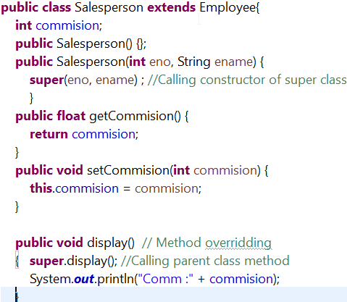
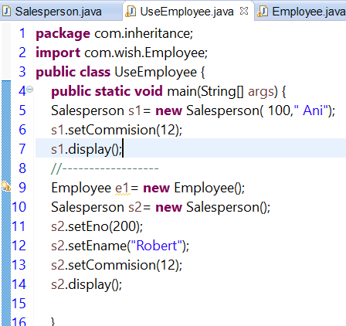
Lab 1:
Create employee as super class
Private eno
String name
Private basicsalary();
Create Manager and inherit Employee
Add designation
Display total salary with 50% increment along with other data.
Create Salesperson
Add designation

